Slide 1
Web-development
Basics

Slide 2
SASIO Training perfectly crafted for you!

Slide 3


Slide 4


Slide 5
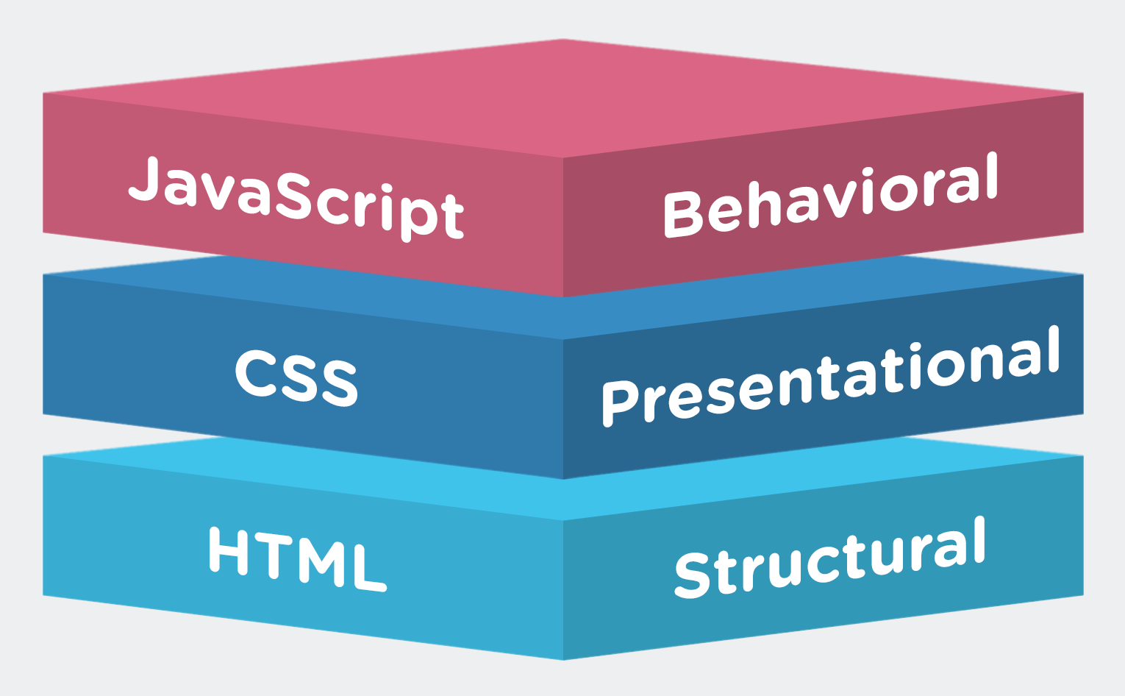
Building Chat Bot
Kabeer

Slide 6


Slide 7
Agenda
Website- Basics
Html
Css3
Jquery
Bootstrap
Static web site
Dynamic site -Wordpress

Slide 8
HTML
HTML introduction

Slide 9
Html - Basic tags -sheet
Head
Header ,footer
body
paragraphs
Bold ,strong content
h1-h6
Link tags - <a> -
Adding images
Order list .un-ordered list
Iframe -content loading - <iframe src="URL"></iframe>

Slide 10
Images
<img src="image.jpg" alt="my image">

Slide 11
Html - Basic tags
Video
<video width="400" controls>
<source src="video.mp4" type="video/mp4">
</video>
Audio
<audio controls>
<source src="filename.mp3" type="audio/mpeg">
</audio>

Slide 12
Embed youtube
<iframe width="854" height="480" src="https://www.youtube.com/embed/IRFcVvahCWQ" ></iframe>

Slide 13
Get User input -text
Text Inputs
-------------
<input name="firstname" type="text">

Slide 14
Drop Downs
<select name="names">
<option value="user1">user1</option>
<option value="user2">user2</option>
</select>

Slide 15
Text-area & email
<textarea name="message" >A huge message </textarea>

Slide 16
Buttons & Range
<button type="button" >i am a button</button>
<input type="range" >

Slide 17
Date & password
<input type="date" >
<input type="password" >

Slide 19
CSS

Slide 20
What id and class & Selectors?

Slide 21
Inernal Style sheets
Internal :
<style>
body {
background-color: red;
}
</style>

Slide 22
External
<head>
<link rel="stylesheet" type="text/css" href="style.css">
</head>

Slide 23
Important css properties

Slide 24
Chat Bot -Node Basics
width/height
box model
text-align
Disply type
Postions
float
shadows
color
background-color
background-image: url("test.png");
Borders
Margin
padding

Slide 25
Shadows
Text shadows :
h1 {
color: white;
text-shadow: 2px 2px 4px #000000;
}

Slide 26
Box-Shadows
div {
width: 300px;
height: 100px;
padding: 15px;
background-color: red;
box-shadow: 10px 10px;
}

Slide 27
Jquery
Why Jquery ?

Slide 28
Installing Jquery
<head>
<script src="jquery-3.3.1.min.js"></script>
</head>
Or
<head>
<script src="https://ajax.googleapis.com/ajax/libs/jquery/3.3.1/jquery.min.js"></script>
</head>

Slide 29
Short test
$(document).ready(function(){
alert(“jquery added”)
});

Slide 30
Basic functions
$(document).ready(function(){
$("button").click(function(){
$(“.hide").hide();
});
});

Slide 31
Jquery Events
Click
load/ready
mouseenter/mouseleave
Change,focus,blur
keypress

Slide 32
Testing Events
$(document).ready(function(){
$("p").click(function(){
$(this).hide();
});
});

Slide 33
Properties
$(document).ready(function(){
$("p").click(function(){
$(this).hide();
});
});

Slide 34
Fade

Slide 35
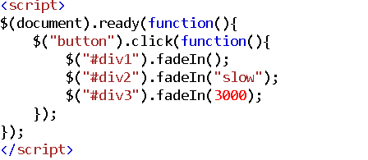

Slide 36
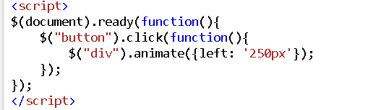
Animate

Slide 37
Add Class & remove

Slide 38
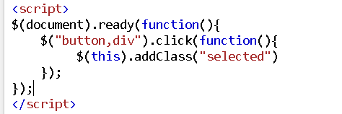

Slide 39
Jquery Appending Values

Slide 40
Append Example

Slide 41
Bootstrap

Slide 42
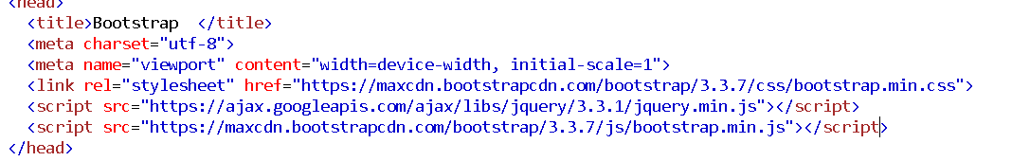
Installation

Slide 43
Container vs Container fluid

Slide 44
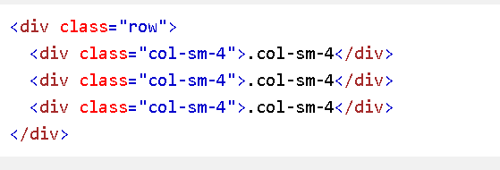
Bootstrap grids

Slide 45
Bootstrap tables

Slide 46
Gallary

Slide 47
Alerts

Slide 48
Modals
Filters
Sliders
Collapse

Slide 49
Full theme

Slide 50
Dynamic Wordpress

Slide 51
Thank You
http://sasio.in
mustafa0528@gmail.com
kabeeraamiri@gmail.com
+91-9003039766

